Slide 1

Filtering not properly fitted countries using MSSE
01월 04일
서울대학교 박태성 교수님
생물정보통계 연구실
박사과정 구태완 석사과정 한결희, 이도은
학부과정 고영현, 김학용, 김태현, 정혜원

Slide 2
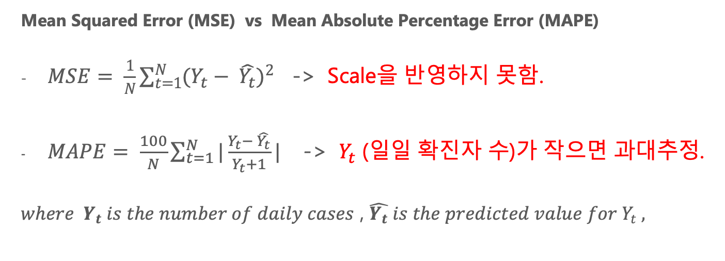
MSE vs MAPE
Mean Squared Error (MSE) vs Mean Absolute Percentage Error (MAPE)
$MSE= \frac{1}{N}\sum_{t=1}^{N}{{(Y_{t}− \hat{Y_{t}})}^{2}}$ -> Scale을 반영하지 못함.
$MAPE= \frac{100}{N}\sum_{t=1}^{N}{|\frac{Y_{t}− \hat{Y_{t}}}{Y_{t}+1}|}$ -> $Y_{t}$ (일일 확진자 수)가 작으면 과대추정.
$where Y_{t} is the number of daily cases$ , $\hat{Y_{t}} is the predicted value for Y_{t} ,$

Slide 3
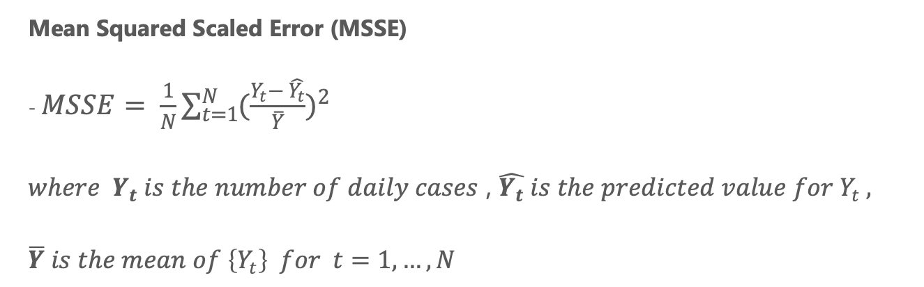
MSSE
Mean Squared Scaled Error (MSSE)
- $MSSE= \frac{1}{N}\sum_{t=1}^{N}{{(\frac{Y_{t}− \hat{Y_{t}}}{\overline{Y}})}^{2}}$
$where Y_{t} is the number of daily cases$ , $\hat{Y_{t}} is the predicted value for Y_{t} ,$
$$\overline{Y} is the mean of \left\{Y_{t}\right\} for t=1, …, N$$

Slide 4
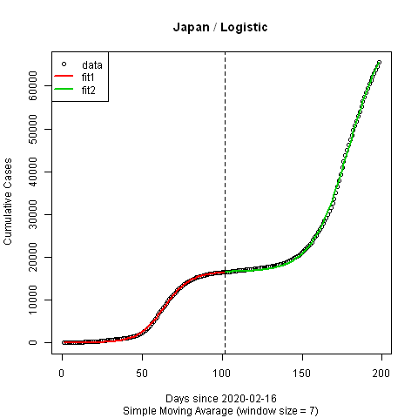
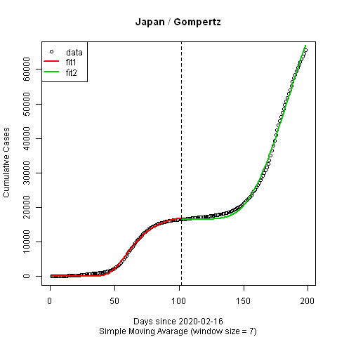
MSSE = 0.0472408101620523
MSSE = 0.095499693868303

Slide 5
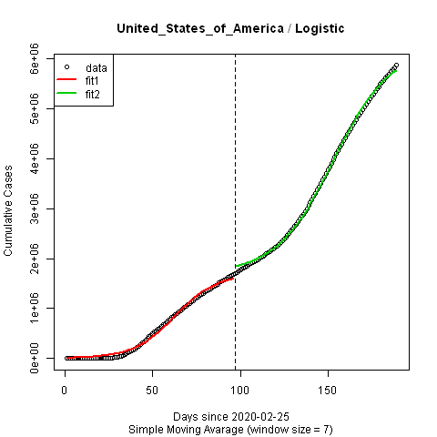
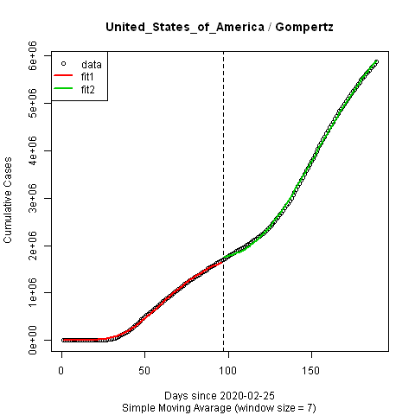
MSSE = 0.0656212441858175
MSSE = 0.0230935353651733

Slide 6
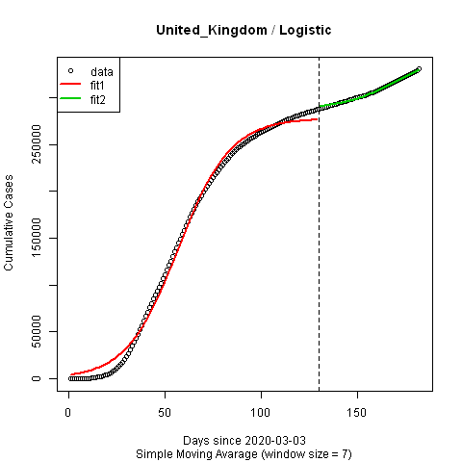
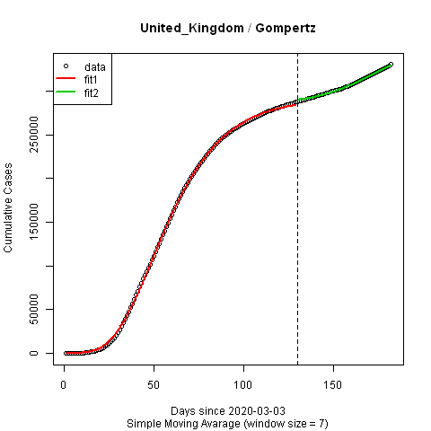
MSSE = 0.073450844261742
MSSE = 0.0251241604433823

Slide 7
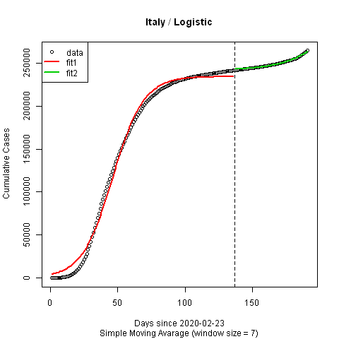
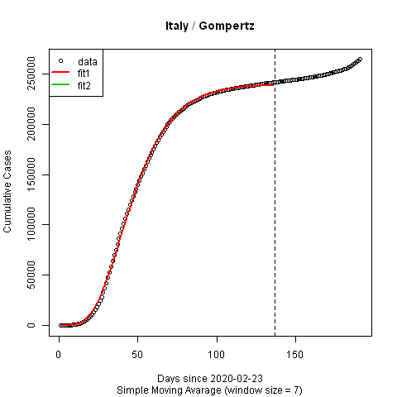
MSSE = 0.1474903497915
MSSE = 0.0219116461768186

Slide 8
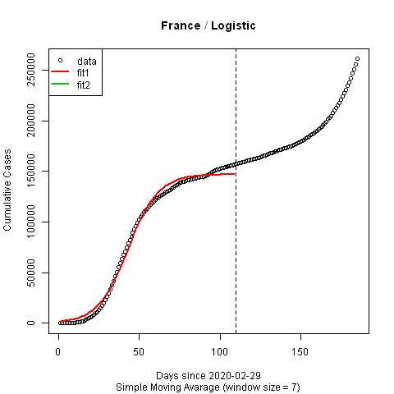
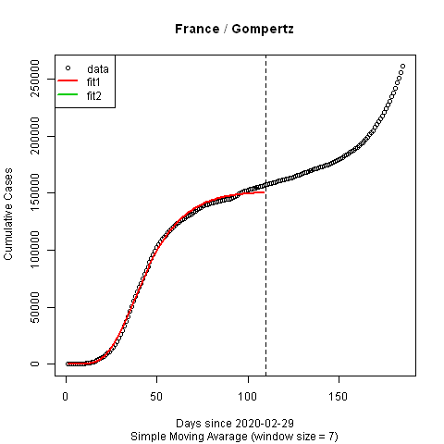
MSSE = 0.126514391218183
MSSE = 0.0523266231286347

Slide 9
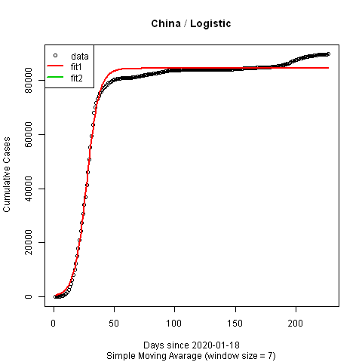
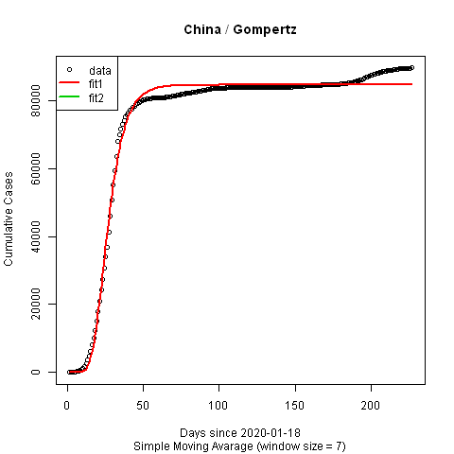
MSSE = 0.325181978417923
MSSE = 0.582192867942544

Slide 10
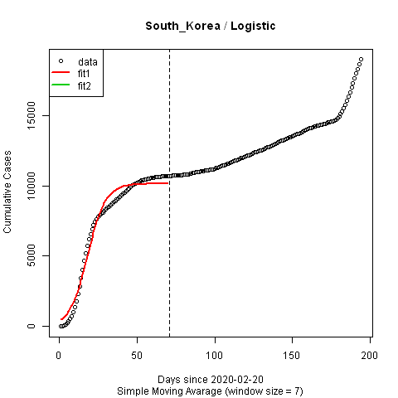

MSSE = 0.332924377554716
MSSE = 0.188891727825744

Slide 11
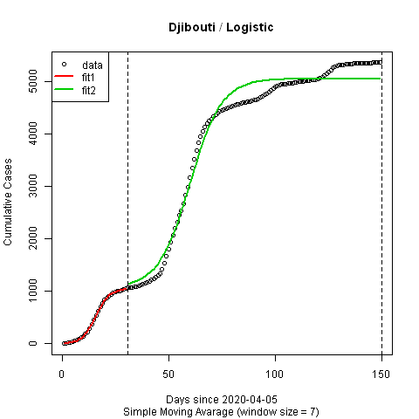
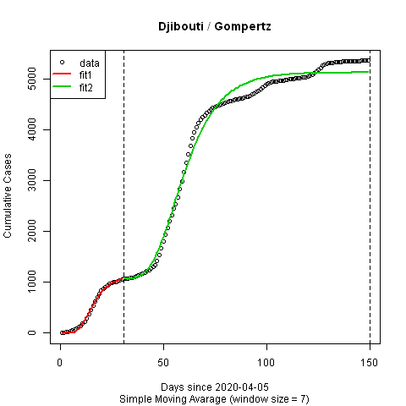
MSSE = 0.262227536686218
MSSE = 0.297786683326851

Slide 12
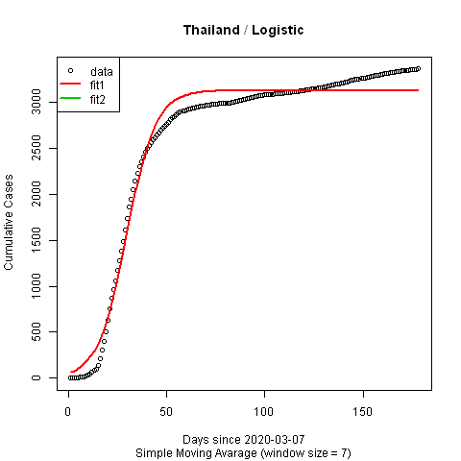

MSSE = 0.409838367855645
MSSE = 0.220907456275208

Slide 13
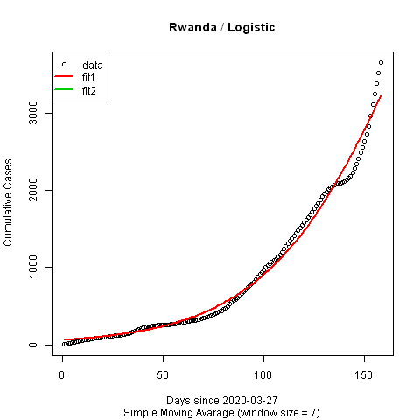

MSSE = 0.707876818681935
MSSE = 0.651178020925684

Slide 14
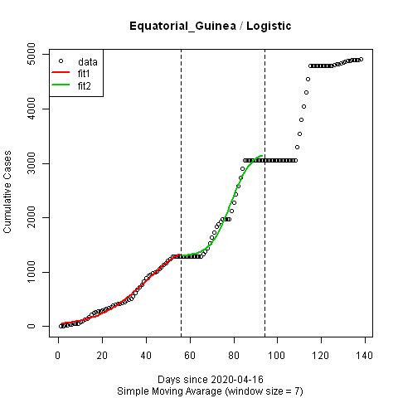
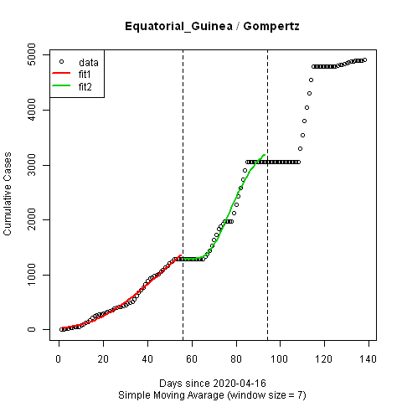
MSSE = 0.63867981951264
MSSE = 0.688163764513623

Slide 15
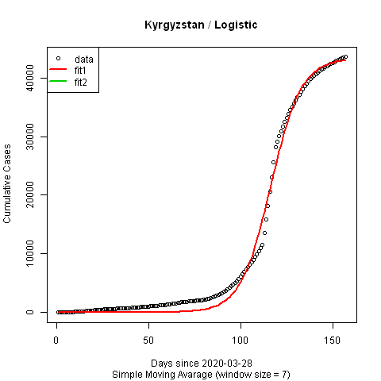
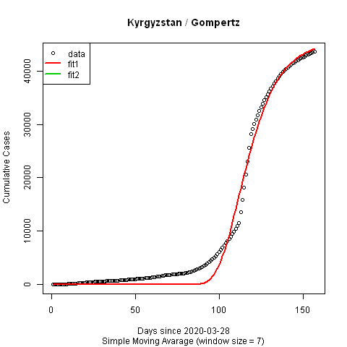
MSSE = 1.02293143702645
MSSE = 1.27271534445623

Slide 16
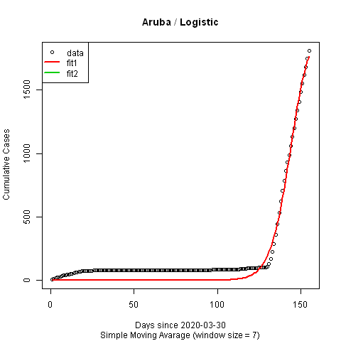
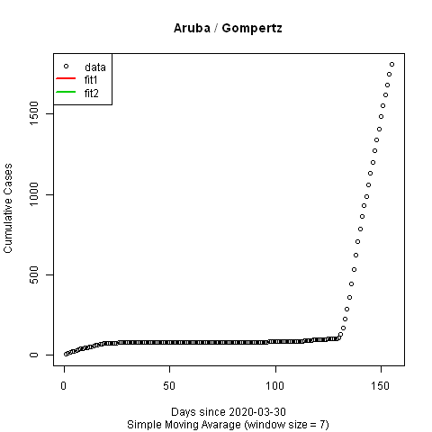
MSSE = 0.41355852911879
Not fitted

Slide 17
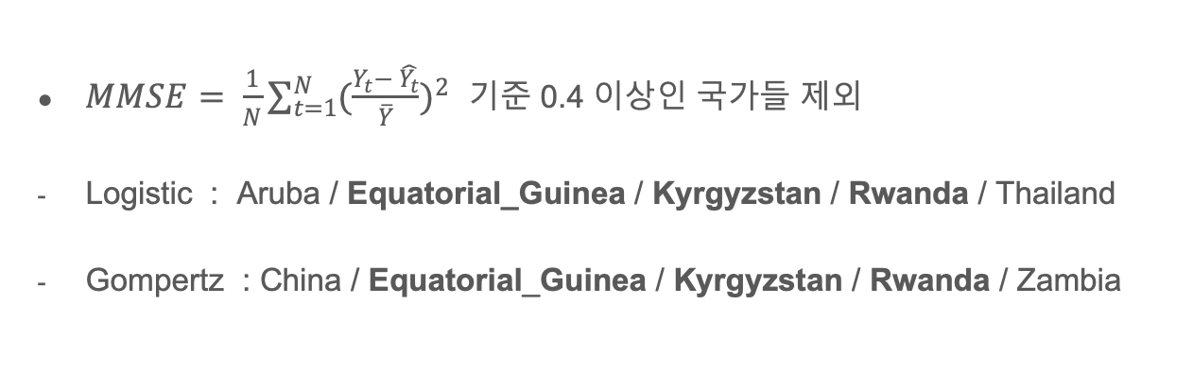
결론
$MMSE= \frac{1}{N}\sum_{t=1}^{N}{{(\frac{Y_{t}− \hat{Y_{t}}}{\overline{Y}})}^{2}}$ 기준 0.4 이상인 국가들 제외
Logistic : Aruba / Equatorial_Guinea / Kyrgyzstan / Rwanda / Thailand
Gompertz : China / Equatorial_Guinea / Kyrgyzstan / Rwanda / Zambia

